Slide 1

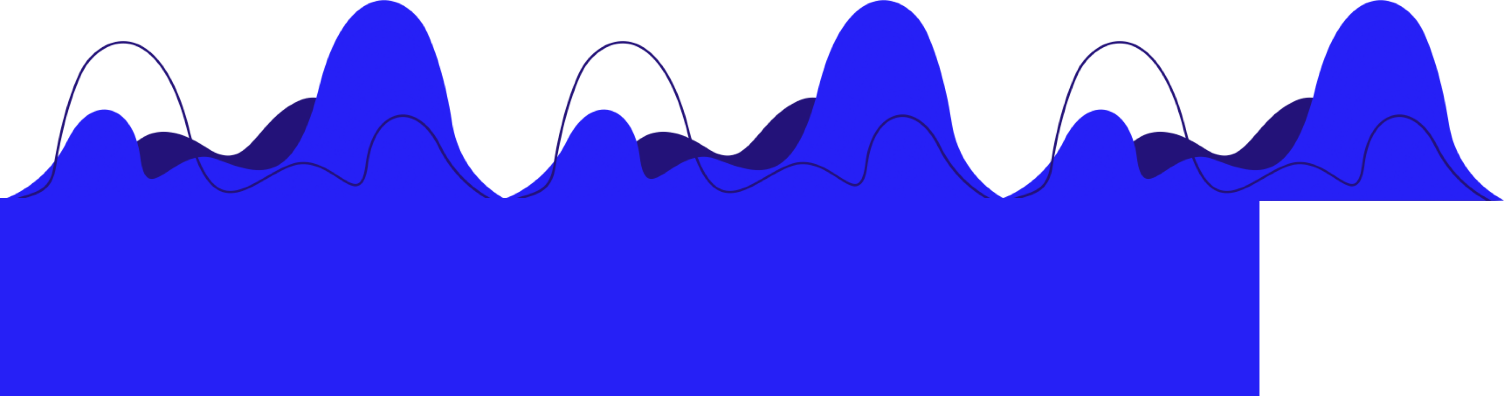
TARDIS
Claire Wang, Charles Duong, Andrew Gao, Neel Redkar
Conrad Challenge 2021

Slide 2


PROBLEM
More than 100 million Americans are not getting enough sleep, or more importantly, high quality sleep.
Up to 1 billion people (almost 1 in 6 people) have suffered from neurological disorders.
20% of American adults suffer from some form of anxiety disorder.
The pandemic is making things worse than ever.
Many BIPOC and low-income individuals lack access to treatment.
Native Americans, biracial people, and other groups experience higher rates of PTSD, depression, and other mental health disorders.
Source: https://www.psychiatry.org/psychiatrists/cultural-competency/education/mental-health-facts
There are large disparities in access to mental health treatment.

Slide 3
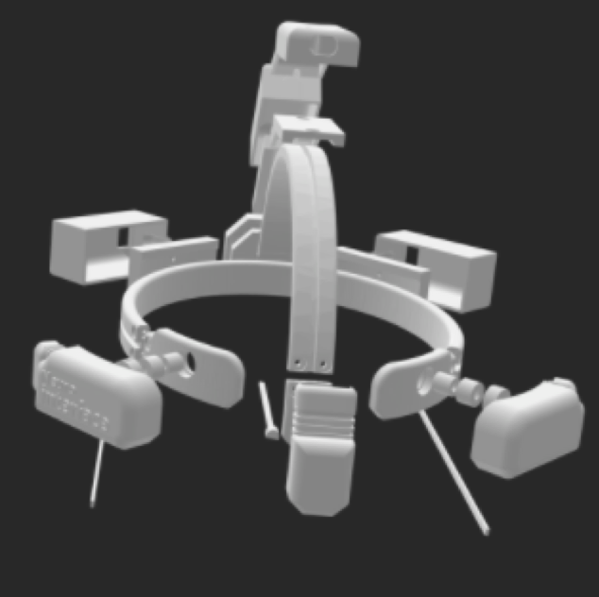

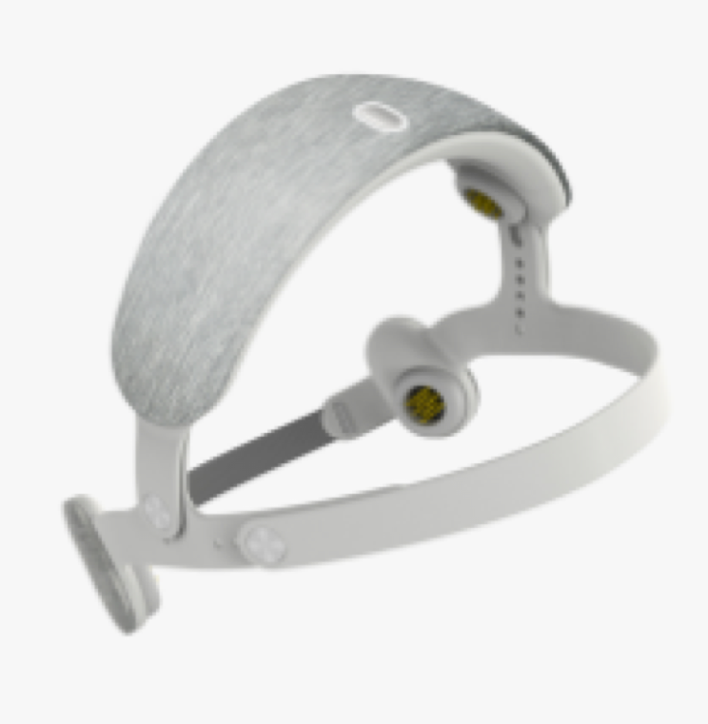
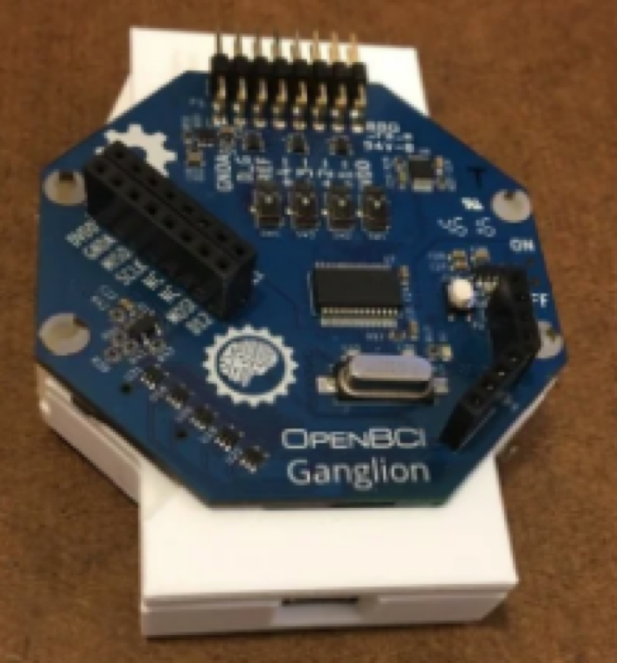
Current Solutions
Ineffective
TARDIS: $180
Treatments for anxiety disorder work only 50% of the time. Most treatments are purely trial-and-error.
Invasive
Treatments are very invasive, such as DBS or Neuropace, where surgery is required. Or, they are subcutaneous or have many side effects.
Urgotech: $500
Expensive
OpenBCI: $600
Prohibitive high prices affect BIPOC and underserved people disproportionally, and trial-and-error exacerbates the situation.
Opal: $200/yr

Slide 4
SOLUTION: TARDIS
Transcranial Applicable Repeating Deep Interchanging Stimulation
TARDIS is a response to the widespread pandemic of demotivation and disinterest of today. By enhancing every different aspect of the day to be higher-quality, we can impact the lives of people of all ages and walks of life.
Accessible
TARDIS is low cost and easy to use and customize.
Interactive
The app allows personalized feedback and training, giving the user the choice to choose their goal and stick with it.
Effective
We don’t sacrifice quality – our initial prototype tests show it is effective and there is much research supporting our findings.
Ethical
We use 100% noninvasive technology that gives only positive long-term effects, and easy to remove.

Slide 5
Solution
in 2 parts
Part 1: Detect
Using an EEG (electroencephalogram) we detect changes in brain waves and send it wirelessly to the user’s phone through an app.
Part 2: Modulate
Using a tDCS, we can gently modulate the user’s brain waves to be closer to the user’s goal, be it to focus or sleep or stay calm.
This means usage can result in long-term positive effects even without the TARDIS cap on.

Slide 6


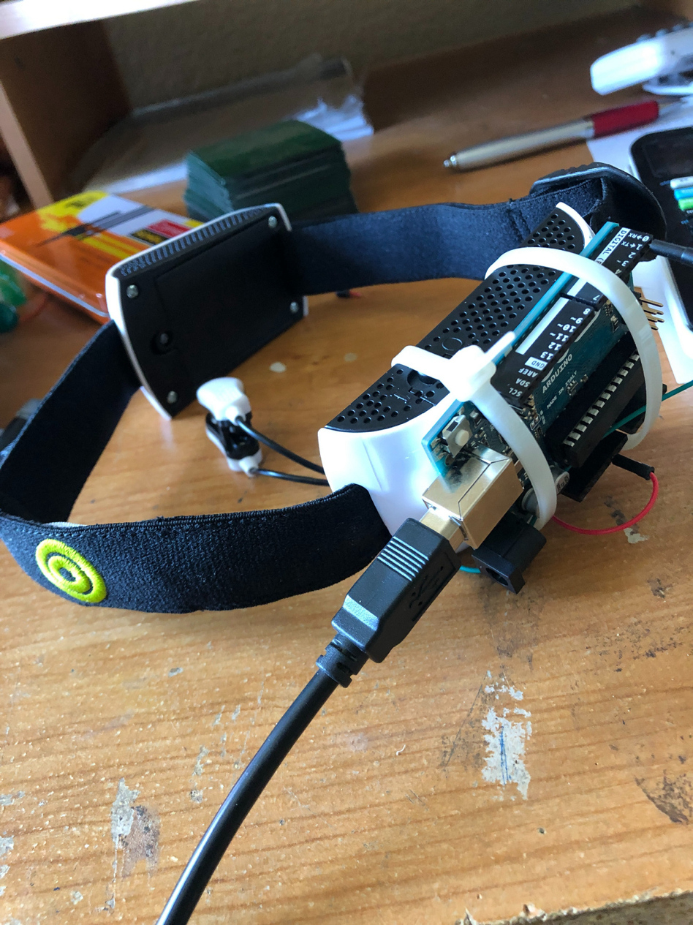
Solution
in 3 steps
Data Collection
An EEG collects brain wave and electrophysiological data from the patient and uses an custom computer chip to send it to the host computer
Processing & Notification
TARDIS Prototype
Data is sent to our mobile app where a custom AI model instantly analyzes the data and determines the user's mental state based on past research and notifies the user if there is anomalous activity.
Entrainment
With consent, the electrodes switch their function to gently alter brain waves through magnetic stimulation, pushing them toward the desired amplitude.

Slide 7
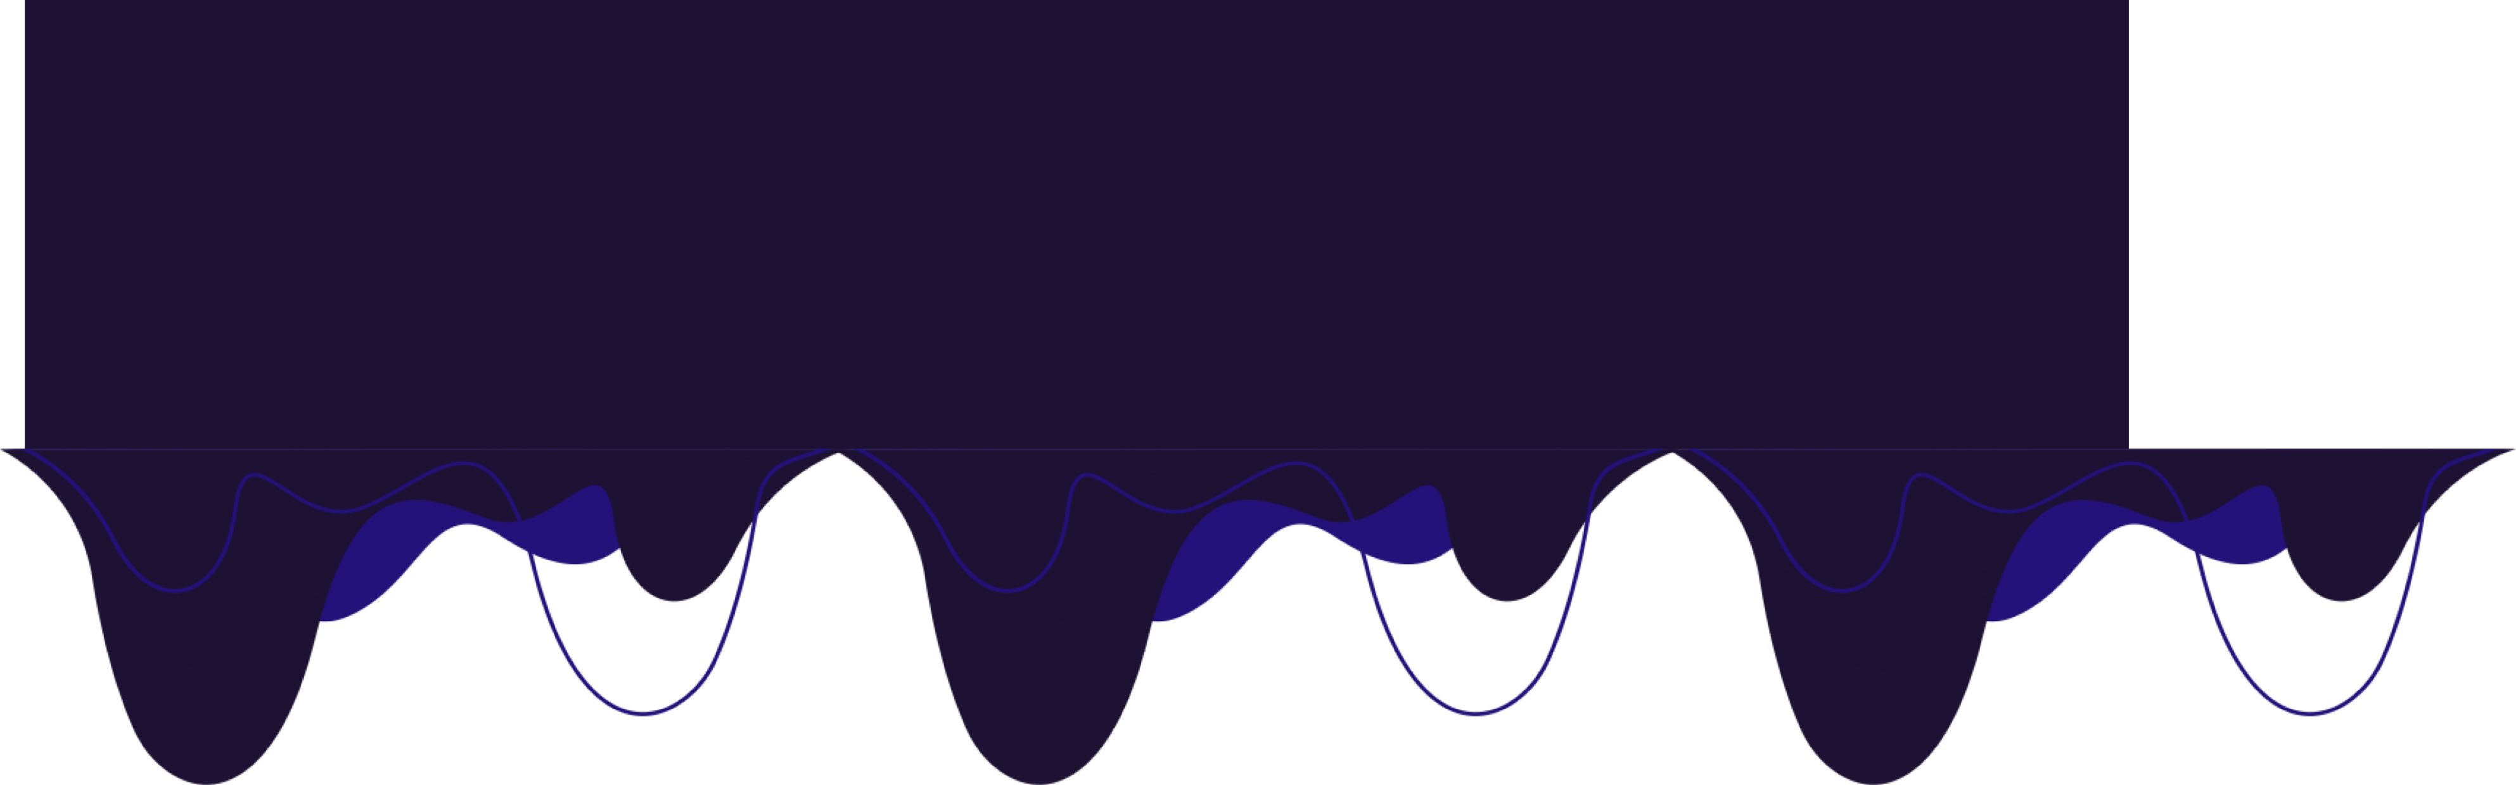


TDCS Emitters
(The "modifers") of the design, and where the magic happens
Processing Chip + Bluetooth chassis
EEG Sensors (Detect brain Waves)
TARDIS Model

Slide 8

Market Analysis
In 2020, the size of the global sleep aids market alone was $67.37 billion.
The global brain health supplements market size was ~$7.1 billion in 2020.
The global behavioral health software market is estimated to reach $5 billion by 2027.
These markets rely heavily on the use of renewing medication and unreliable trial-and-error solutions.
Demographically, we initially target two groups of people:
Older people (>45) are more likely to face neurological disorders that affect sleep and cognition.
Younger people (14-21) are more likely to face mental health conditions, especially anxiety disorders.
Both also have exhibited decreased impact from current solutions.

Slide 9
Market Adoption
phases 1 and 2
We plan to utilize an initial 2 phase launch approach.
Phase I
Phase II
We plan to:
Launch product on online platforms
Begin marketing
Test effects on atypical patients, which may require medical approval
We plan to:
Consult with biotechnology experts
Do testing on healthy adult volunteers
Work to perfect the product and collect data
Funds & Investment:
We estimate needed funds to be ~$200K, including needed technology components, patent attainment, and consultation fees.
Funds & Investment:
We will need ~$1 M combined for Semis A and B to cover costs of mass production, marketing, and tech.
We plan to start a Series A Convertible Note offering for investors who invest above 5% of our goal and provide equity. Additionally, we aim to give amounts to consultants and partnered companies.

Slide 10

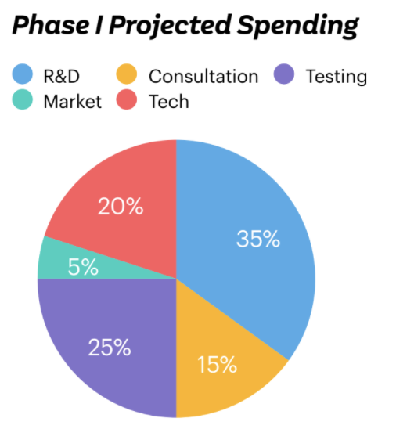
Unit Cost:
$179.99
1
$10.00
5-core and twin-core shield cables
$
2
$30.00
Six EEG electrodes
3
$28.00
tDCS stimulating electrodes
We plan to sell one unit of TARDIS for $179.99, giving a profit margin of 75%.
4
$35.00
Custom processing chip/raspberry Pi to interact with mobile app.

Slide 11
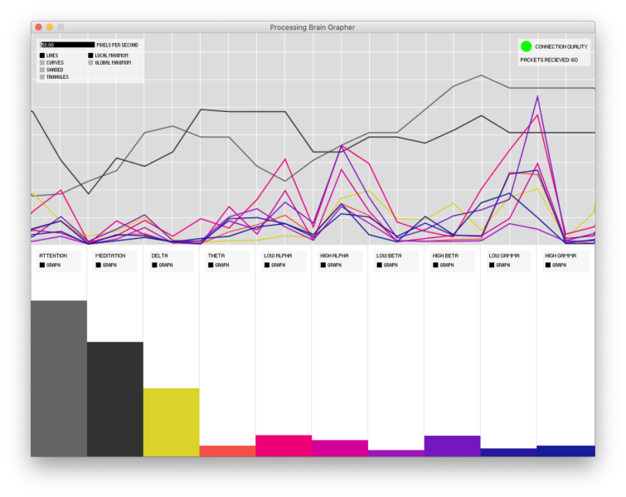
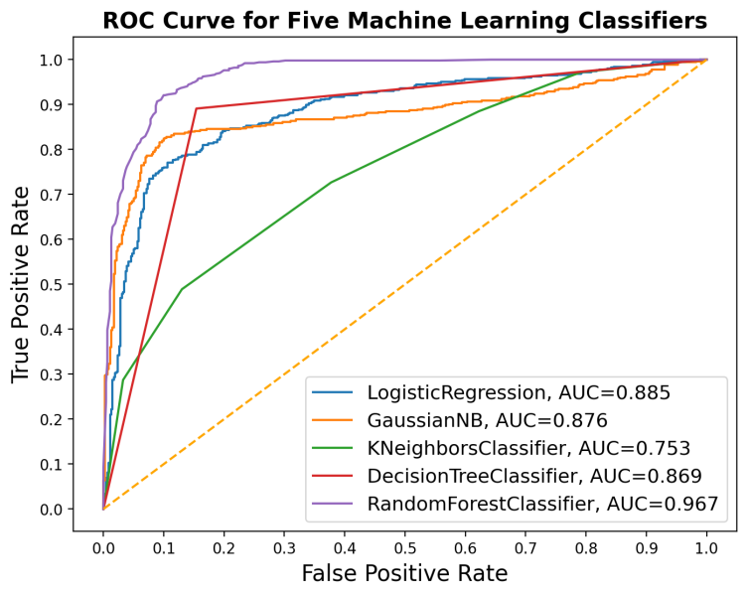
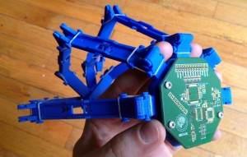
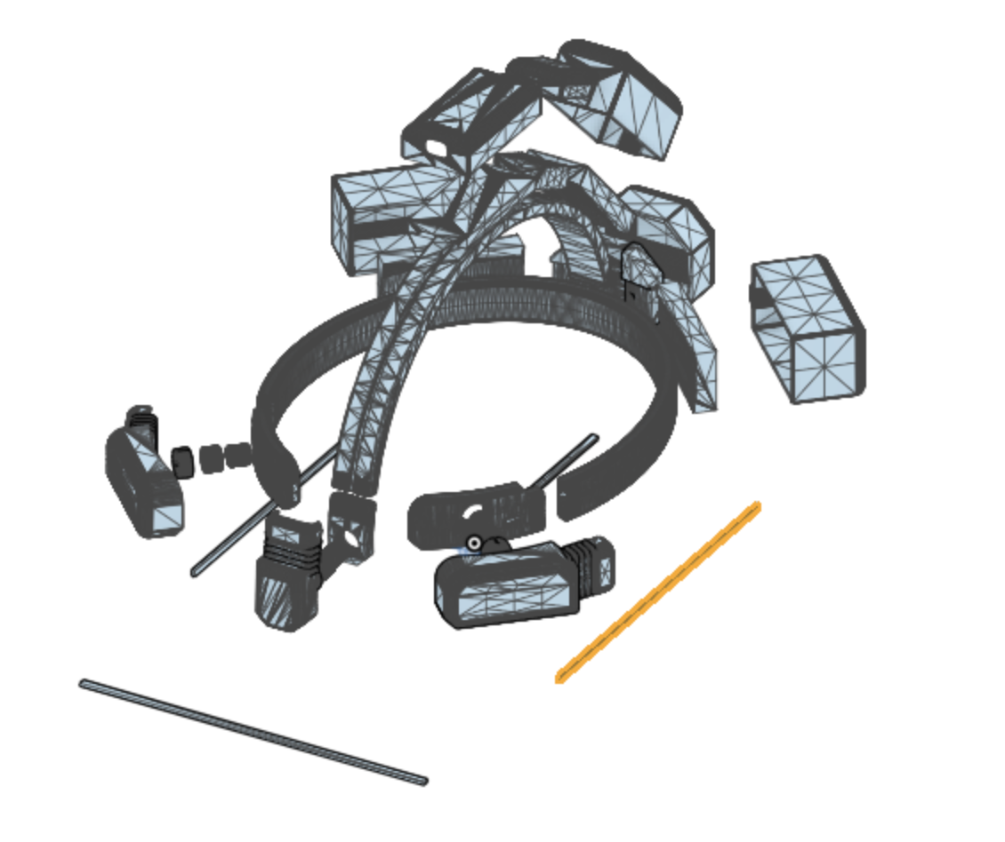
Current Progress
We have already begun initial product production using our CAD design and doing AI model training to test how much correlation there is between brain wave activity and physical activity. There is a high correlation!

Slide 12

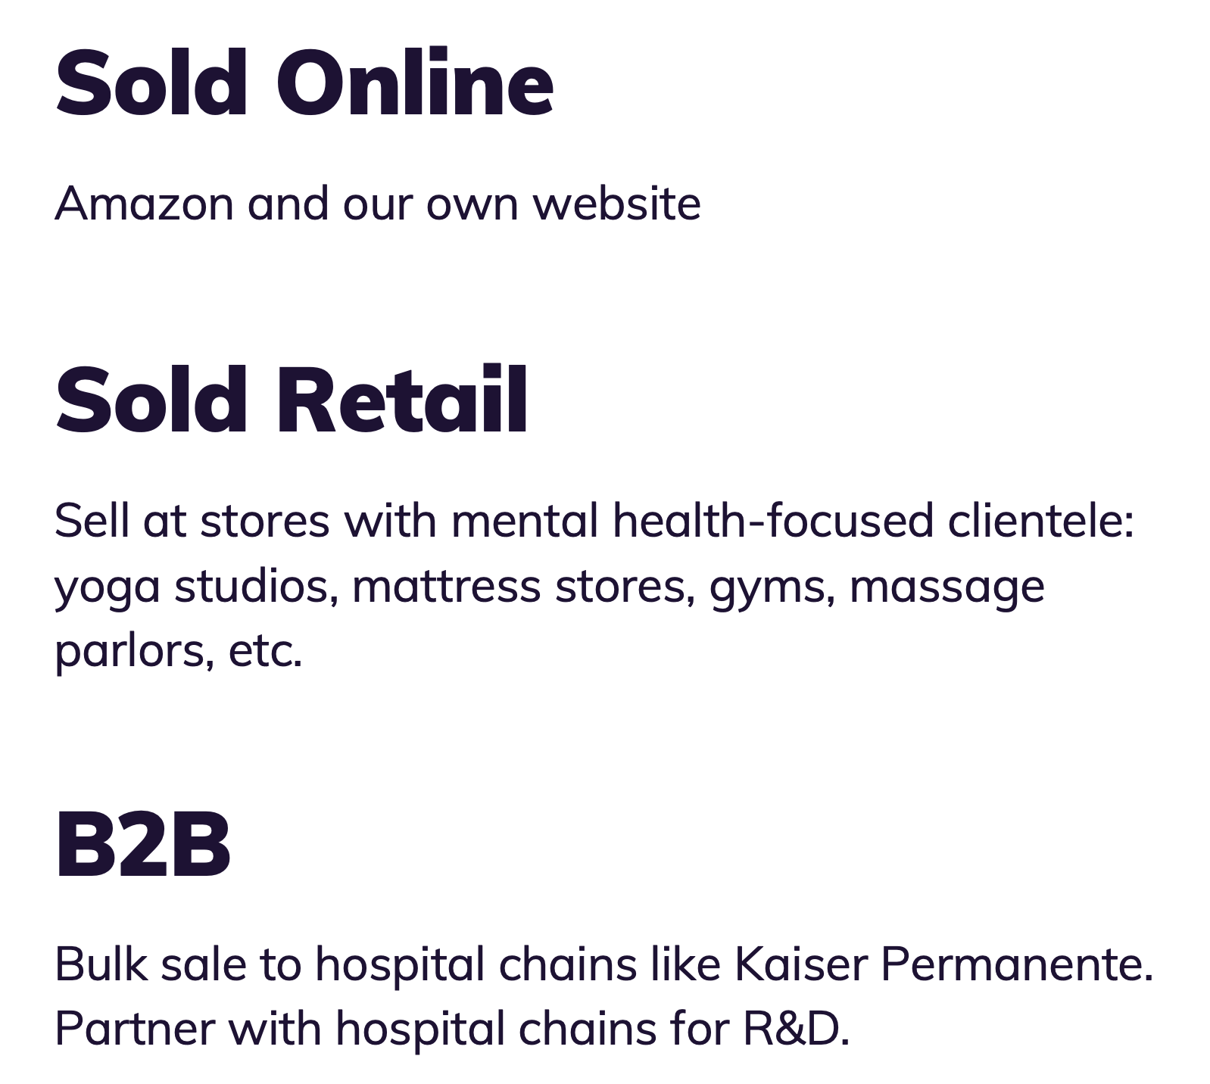

Business Model

Slide 13

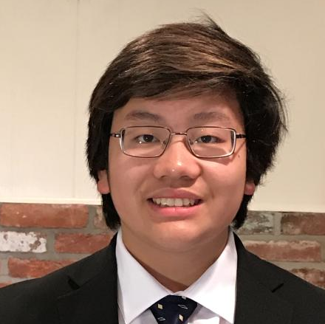
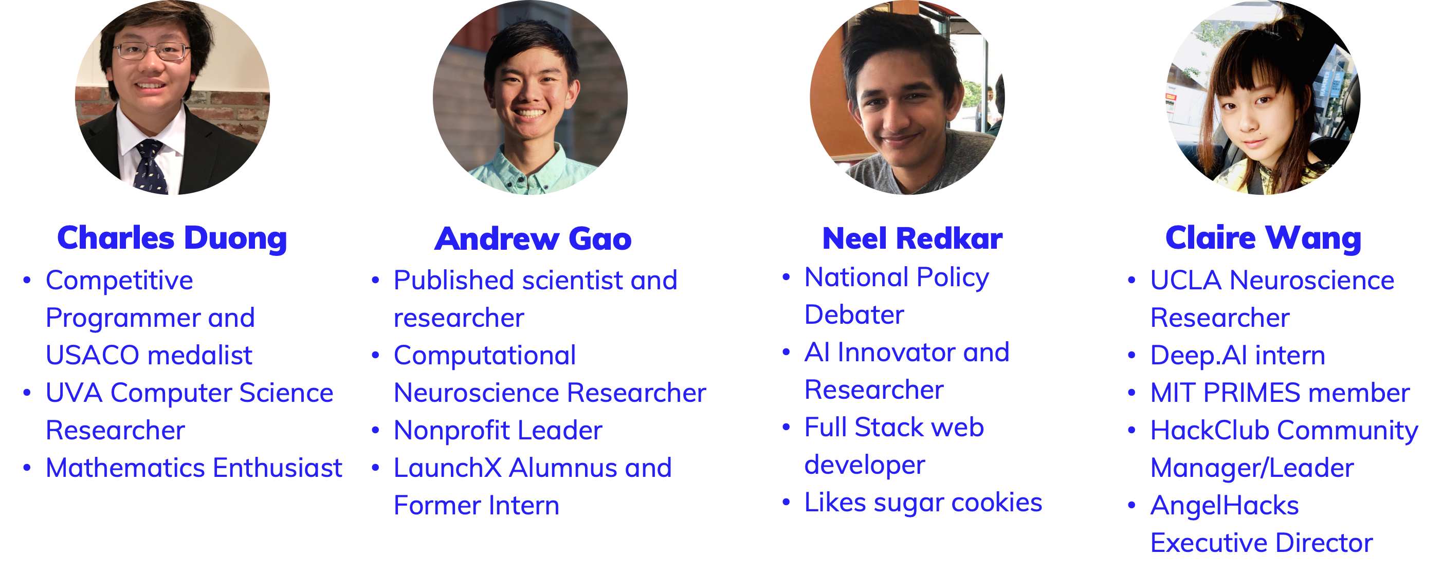
Thank you for your interest!
The Team

